Slide 1
PhysioNet Challenge – AF classification
Speaker: Yu-Cheng, Lin
Advisor:
Date: 2019/9/26

Slide 2
Outline
Paper survey(2,5,8,11)
Related topics
Conclusion
Reference

Slide 3
Paper 2

Slide 4
About this paper
Title: ENCASE: an ENsemble ClASsifiEr for ECG Classification Using Expert Features and Deep Neural Networks
Author: Shenda Hong, Meng Wu, Yuxi Zhou, Qingyun Wang, Junyuan Shang, Hongyan Li, Junqing Xie
Final accuracy: 0.84 F1 score

Slide 5
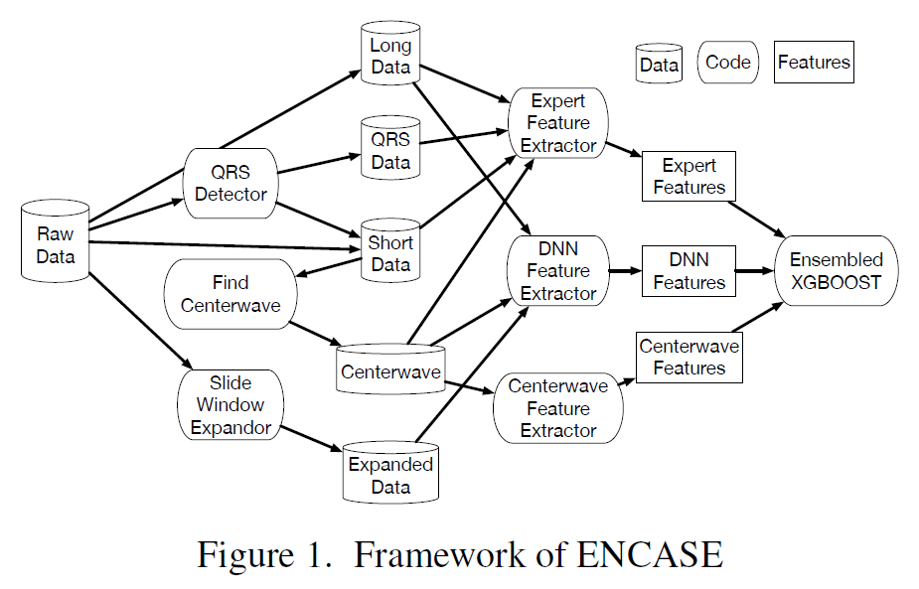
Framework
Data
Features

Slide 6
Data
There are 5 kinds of data under different preprocess.
1. Long data: Raw values
2. Short data: Split long data into short waves using QRS detector
3. QRS data: The length of consecutive QRS interval of long data
4. Centerwave:
5. Expanded data: Slide window(6000) and strides dynamically chosen for data balancing

Slide 7
Features
There are 3 kinds of features:
1. Expert features: Based on Statistical, DSP, medical knowledge
2. Centerwave features: Find the most representative data from one patient
3. Deep features

Slide 8
Features – Expert features
Statistical: count, mean, max, min, range, variance, skewness, …, zero-crossing, zigzag, …
DSP: FFT, frequency-band power
Medical knowledge: Sample entropy, Coeff. of variation and density histograms(CDF), median absolute deviation(MAD)

Slide 9
Features – Centerwave features
3 steps:
1. Calculate pairwise DTW distance of his/her short data.
2. Spectral clustering
3. Find the center(closest to other node) of the largest cluster
Then, extract statistical and medical features on centerwave

Slide 10
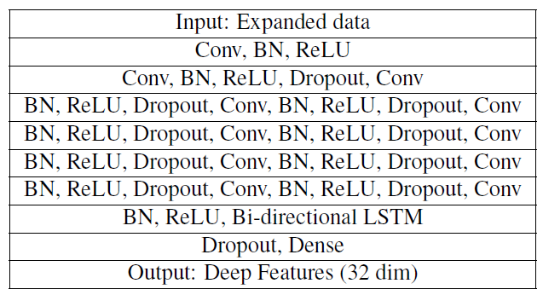
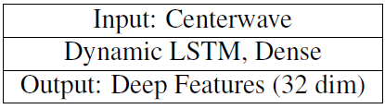
Features – Deep features
Two models:
Remove the output layer(last hidden layer as features)

Slide 11
Training
1. Boosting (XGBoost, each 3000 trees & 9 depth & 3 min-child-weight)
2. Ensemble(Average prob., 5 XGBoost)

Slide 12
Paper 5

Slide 13
About this paper
Title: Cardiac Rhythm Classification from a Short Single Lead ECG Recording via Random Forest
Author: Ruhi Mahajan, Rishikesan Kamaleswaran, John Andrew Howe, Oguz Akbilgic
Final accuracy: 0.78
These entries were disqualified because they included code that was not freely licensed, contrary to the Challenge rules. The code in question has been removed from the archives linked above.
These entries were disqualified because their authors submitted more than ten entries in total, contrary to the Challenge rules.

Slide 14
Framework
Preprocessing
Features
Feature
Selection
(GA-based)
Training
(Random
Forest)

Slide 15
Preprocessing
All ECG band-pass filtered between 5~26 Hz, to remove power-line interference
Down-sampled to 200Hz to decrease computation

Slide 16
Features
Total 62 features:
PSPR
Wavelet decomposition
SampEn
VLF(very low frequency average power)
pNN50(percentage of beats greater than 50ms)
Mean, median, kurtosis, deviation, skewness, …
RR intervals

Slide 17
Feature selection
Running GA-based algorithm to select the most significant features
62 features to 37 features

Slide 18
Training
Bootstrap-aggregate decision trees(Boosting, 220 trees)

Slide 19
Paper 8

Slide 20
About this paper
Title: Convolutional Recurrent Neural Networks for Electrocardiogram Classification
Authors: Martin Zihlmann, Dmytro Perekrestenko, Michael Tschannen
Final accuracy: 0.821

Slide 21
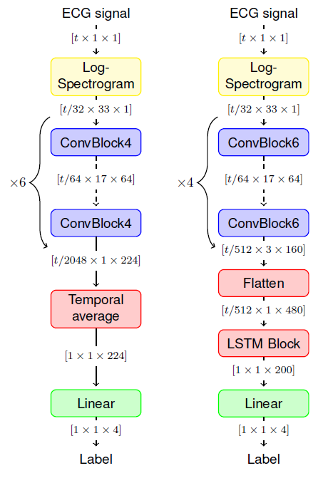
Framework
Two models: CNN & CRNN
Log-spectrogram: 0.25-Tukey window & 0.5 overlap
ConvBlockx: x ConvLayer & BN & Relu
LSTM Block: 3-layer LSTM
Aggragation accros time: Temporal average in CNN & LSTM in CRNN
<

Slide 22
Training
Training protocols in CRNN(due to convergence): (1) replace LSTM with Temporal average and train 500 epochs (2) change back to LSTM, fixed CNN and train 100 epochs (3) training jointly for 200 epochs(0.1 learning rate)
Augmentation: Dropout bursts(uniformly selected 50ms), Random resampling
Ensemble: 5 models & Train again(Train/Valid = 1/5)

Slide 23
Paper 11

Slide 24
About this paper
Title: Automatic Detection of Atrial Fibrillation and Other Arrhythmias in Holter ECG Recordings Using Rhythm Features and Neural Networks
Authors: Filip Plesinger, Petr Nejedly, Ivo Viscor, Josef Halamek, Pavel Jurak
Final accuracy: 0.81

Slide 25
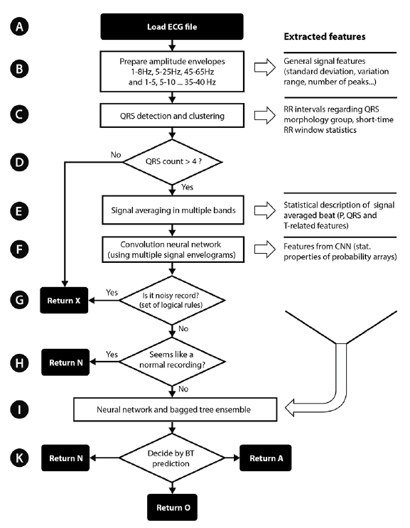
Framework

Slide 26
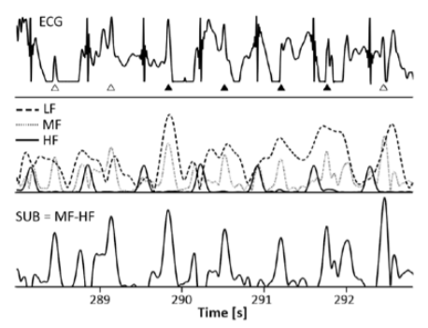
Envelograms
Transform into LF, MF, HF
QRS detections on R = MF - LF
Refer to [1]

Slide 27
Morphology group
MG are clustered by correlation
RR-crossing and distribution as features
RR-std as features

Slide 28
CNN features
15Conv + Relu + 3Conv + Softmax ???
Max, min, mean, std of output layer as features

Slide 29
Training
Total 277 features
25Linear + 3Linear ???
Bagged tree(Boosting)

Slide 30
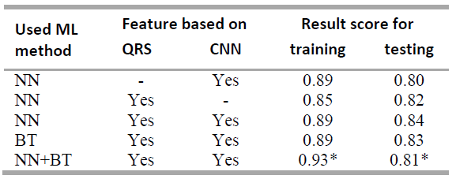
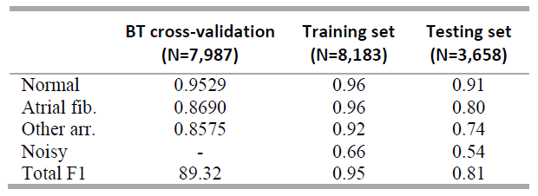
Results

Slide 31
Conclusion
CNN or LSTM
+
Ensemble
+
Boosting
+
(Augmentation)
Statistical features
+
Expert features
+
Boosting

Slide 32
Related topics
ML lectures
(http://speech.ee.ntu.edu.tw/~tlkagk/courses_ML19.html)
Anormal detection (Noise detection)
(http://speech.ee.ntu.edu.tw/~tlkagk/courses/ML_2019/Lecture/Detection%20(v9).pdf)
BERT (replacing LSTM)
(http://speech.ee.ntu.edu.tw/~tlkagk/courses/ML_2019/Lecture/Transformer%20(v5).pdf)
(http://speech.ee.ntu.edu.tw/~tlkagk/courses/ML_2019/Lecture/BERT%20(v3).pdf)

Slide 33
Reference
[1] Taming of the monitors: reducing false alarms in intensive care units, F Plesinger et al 2016 Physiol

